Slide 1
PIP4004 - INTERNSHIP Final Review Presentation PROJECT MANAGEMENT / CYBERSECURITY SOLUTIONS
Student Details
Name | Harsh Abhinav A
Roll No | 20211CCS0035
Section | 8CCS03
Batch No. | G-4
Under the Supervision of,
Prof. Dr. Shanthi S
Associate Professor
School of Computer Science and Engineering
Presidency University
Name of the Program: Btech (Computer Science)
Name of the HoD: Dr. Anandaraj S P
Name of the Program Project Coordinator: Dr. Sharmasth Vali Y
Name of the School Internship/Project Coordinators: Mr. Md Ziaur Rahman/Dr. Sampath A K/Dr. Abdul Khadar A

Slide 2
Content
About Company or Organization
Working domain or the technology
About your team and reporting Manager
Challenges Faced in Internship
Objectives of the work
Literature Review
Proposed System
Problem Statement
System Requirements
Advantages of Proposed System/Work
Internship Roadmap
Github Link

Slide 3
About Company or Organization
Cyber Dojo is an initiative of Bridge Systems & Services. Cyber Dojo leads in cybersecurity education, forming strategic partnerships with top Indian universities. training programs seamlessly blend academic rigor with hands-on labs, continually updated by our technical team to align with industry trends. next-gen simulation labs in Red, Blue, and Purple Teaming scenarios.
employability through internships, industry exposure, and project support. Mentorship from industry experts via parent company's alliance ensures a practical approach to education. This comprehensive strategy ensures Cyber Dojo graduates are not just knowledgeable but well-prepared for the dynamic cybersecurity landscape

Slide 4
Working domain or the technology
Building Lab Scenarios
Creating lab scenarios involves designing controlled environments to test software, security protocols, or user interactions. These scenarios help evaluate system performance, user experience, and security vulnerabilities in a risk-free setting. Steps to build effective lab scenarios include:
Defining Objectives – Establish clear goals for testing, such as performance benchmarking or security analysis.
Creating Test Cases – Develop structured test cases to assess different system functionalities.
Executing and Monitoring – Run tests, collect data, and analyze performance.
Iterating & Refining – Adjust scenarios based on findings to improve accuracy and effectiveness.

Slide 5
Working domain or the technology
Content testing
ensures digital content meets quality, accessibility, and compliance standards before public release. Content moderation involves reviewing and filtering user-generated content to prevent harmful or inappropriate material.
Manual Review – Human moderators assess nuances AI may miss, such as context and intent.
User Experience Testing – Evaluating readability, accessibility, and engagement.
Compliance & Policy Enforcement – Ensuring adherence to platform guidelines and legal standards.
Continuous Monitoring & Adaptation – Updating policies and refining moderation based on trends and feedback.

Slide 6
Working domain or the technology
Building Lab Scenarios
Creating lab scenarios involves designing controlled environments to test software, security protocols, or user interactions. These scenarios help evaluate system performance, user experience, and security vulnerabilities in a risk-free setting. Steps to build effective lab scenarios include:
Defining Objectives – Establish clear goals for testing, such as performance benchmarking or security analysis.
Creating Test Cases – Develop structured test cases to assess different system functionalities.
Executing and Monitoring – Run tests, collect data, and analyze performance.
Iterating & Refining – Adjust scenarios based on findings to improve accuracy and effectiveness

Slide 7
About your team and reporting Manager
Solo tasks assigned
Reporting head - HARSH RAVAL (Managing director)
Assigned Mentor - Mansi (Guide)

Slide 8
Challenges Faced in Internship
Lack of Experience & Skills Gap
1)struggle with tasks due to limited technical knowledge or industry experience.
2)Adapting to workplace tools, software, or processes can be overwhelming.
Balancing Workload & Expectations
1)Managing assigned tasks while learning new skills can be stressful.
2)Expectations may not always be clear, leading to confusion about responsibilities.

Slide 9
Objectives of the work
Testing Scenarios
Testing scenarios are crucial for evaluating software, systems, and user interactions in a controlled environment before deployment. Their main uses include:
Identifying Bugs & Errors – Helps detect system failures, performance issues, or vulnerabilities.
Improving User Experience – Ensures smooth functionality, easy navigation, and usability.
Validating Security Measures – Tests how systems handle cyber threats and unauthorized access.
Performance Optimization – Assesses how well an application or system performs under different conditions.
Risk-Free Experimentation – Allows testing of new features or updates without affecting real users.

Slide 10
Objectives of the work
Content Moderation
Content moderation is essential for maintaining safe and high-quality digital platforms. Its primary uses include:
Preventing Harmful Content – Filters out hate speech, misinformation, violence, or explicit material.
Ensuring Compliance – Helps platforms follow legal regulations and community guidelines.
Enhancing User Trust – A well-moderated platform improves credibility and user engagement.
Protecting Brand Reputation – Prevents offensive or misleading content from damaging a company’s image.
Reducing Spam & Scams – Eliminates fake profiles, bots, and fraudulent activities.

Slide 11
Literature Review
Penetration Testing
Simulates real-world attacks to identify vulnerabilities.
Used to test network security, web applications, and endpoint defenses.
Malware Analysis
Focuses on understanding the behavior of viruses, worms, and ransomware in an isolated lab environment.
Intrusion Detection and Prevention Systems (IDPS) Testing
Evaluates the effectiveness of security tools in detecting and blocking cyber threats.
Explore machine learning approaches in intrusion detection systems (IDS).

Slide 12
Literature Review
Digital Forensics Testing
Used to investigate cybercrimes by analyzing logs, files, and system behavior.
Discusses the role of digital forensics in cybercrime investigations.
Cyber Range Simulation
Virtualized environments that mimic real-world networks for large-scale attack simulations.
Highlight the importance of cyber ranges in government and military cybersecurity training.
Manual Moderation
Involves human reviewers analyzing and removing harmful content.
Time-consuming, prone to bias, and psychologically harmful to moderators

Slide 13
Literature Review
Manual Moderation
Involves human reviewers analyzing and removing harmful content.
Time-consuming, prone to bias, and psychologically harmful to moderators
Automated Moderation
Uses algorithms, AI, and machine learning for real-time content analysis.
AI-based moderation tools used by social media platforms

Slide 14
Proposed System / Work
Lab testing in cybersecurity provides a controlled and structured environment to simulate, analyze, and mitigate cyber threats. It plays a crucial role in evaluating security measures, identifying vulnerabilities, and enhancing defense mechanisms before deployment in real-world scenarios
Safe and Controlled Testing Environment
Allows researchers to simulate cyberattacks without risking actual systems.
Provides a risk-free space to test vulnerabilities and security solutions.
Realistic Attack Simulations
Enables security teams to recreate real-world cyber threats such as DDoS attacks, malware infections, and phishing attempts.
Helps organizations understand threat actor tactics and improve incident response strategies.
Cost-Effective Security Assessments
Prevents costly security breaches by identifying vulnerabilities before deployment.
Reduces the need for reactive security fixes, which are often expensive and disruptive.

Slide 15
Proposed System / Work
Testing of Security Tools and Policies
Validates the effectiveness of firewalls, intrusion detection systems (IDS), and endpoint security solutions.
Helps organizations refine security policies and compliance with industry standards (e.g., ISO 27001, NIST, GDPR).
Scalability and Flexibility
Allows testing of different network configurations, cloud environments, and IoT devices.
Can be adapted for penetration testing, malware analysis, and forensic investigations.
Training and Skill Development
Provides a hands-on learning environment for cybersecurity professionals, ethical hackers, and researchers.
Enhances incident response skills through real-time attack and defense exercises.

Slide 16
Proposed System / Work
CONTENT MODERATION plays a vital role in maintaining a safe, secure, and trustworthy digital environment. It helps detect and remove harmful, misleading, or malicious content that could pose cybersecurity risks.
Prevents Cyber Threats and Attacks
Blocks malicious links, phishing attempts, and malware distribution before they reach users.
Reduces the spread of ransomware, spyware, and social engineering attacks.
Reduces the Spread of Misinformation and Fake News
Helps combat deepfake content, fake news, and disinformation campaigns.
Protects users from fraud, scams, and misleading cybersecurity advice.
Protects User Privacy and Safety
Prevents doxxing, cyberbullying, harassment, and identity theft.
Reduces exposure to harmful or violent content that can negatively impact mental well-being.

Slide 17
Proposed System / Work
Enhances Online Trust and Reputation
Platforms that effectively moderate content build trust among users and stakeholders.
Maintains a positive brand image by preventing the spread of illegal or offensive materials.
Ensures Compliance with Legal and Ethical Standards
Helps platforms adhere to laws and regulations such as GDPR, CCPA, and the Digital Services Act.
Reduces the risk of legal action and government penalties for non-compliance.
Improves AI and Machine Learning Models
Continuous moderation helps train AI algorithms to better detect harmful content.
AI-driven moderation can improve over time, reducing false positives and false negatives.

Slide 18
Problem Statement
LAB TESTING: Controlled environment to simulate and analyze cyber threats, evaluate security tools, and test incident response strategies. Despite its advantages, several challenges hinder the effectiveness of cybersecurity lab testing
Resource Constraints: Setting up a comprehensive cybersecurity lab requires significant computational power, specialized tools, and skilled personnel.
Scalability Issues: Many testing environments struggle to scale with emerging threats and advanced attack techniques.
Ethical and Legal Concerns: Simulating cyberattacks in lab environments must comply with ethical hacking guidelines and legal regulations.
Lack of Realism: Simulated environments may not fully replicate the complexity of real-world cyber threats.

Slide 19
Problem Statement
CONTENT MODERATION :The rapid expansion of digital platforms has led to an increase in malicious content, including cyber threats, misinformation, hate speech, phishing attacks, and extremist materials. Traditional content moderation techniques struggle to keep up with the evolving nature of cyber threats, resulting in ineffective detection and mitigation strategy
Ethical and Legal Dilemmas: Striking a balance between content moderation, free speech, and privacy rights remains a significant challenge.
Human and Psychological Impact: Manual content moderation exposes human reviewers to disturbing materials, leading to psychological distress and ethical concerns.
Scalability Issues: As cyber threats grow, moderation systems must handle vast amounts of data in real-time without compromising efficiency.

Slide 20
System Requirements
WINDOWS system with X64 basic configuration and minimum storage requirement
LINUX OS for lab testing
VIRTUAL Machine
Stable Wi-Fi with good bandwidth and speed

Slide 21
Advantages of Proposed System/Work
Aligns Business Strategy with Product Goals
Ensures that product development is aligned with business objectives and market trends.
Helps prioritize features and improvements that contribute to long-term success.
Enhances Customer Satisfaction
Focuses on user needs and pain points to build products that solve real problems.
Conducts market research and feedback analysis to continuously improve the product experience.
Drives Innovation and Competitive Advantage
Encourages data-driven decision-making to stay ahead of competitors.
Enables companies to innovate and adapt to changing market demands.
Improves Cross-Functional Collaboration
Acts as a bridge between engineering, marketing, sales, and design teams.
Ensures smooth communication and alignment across different departments.

Slide 22
Content Moderation
"I've worked in content moderation and development for a cybersecurity course at my ed-tech company, where I was responsible for creating structured course material, curating relevant and accurate content, and developing interview questions to assess learners' understanding. My role also involved researching up-to-date industry trends and ensuring the quality and relevance of all educational content.“
Cybersecurity course
Fundamentals design
Content generating
Event planning

Slide 23

Content Moderation

Slide 24
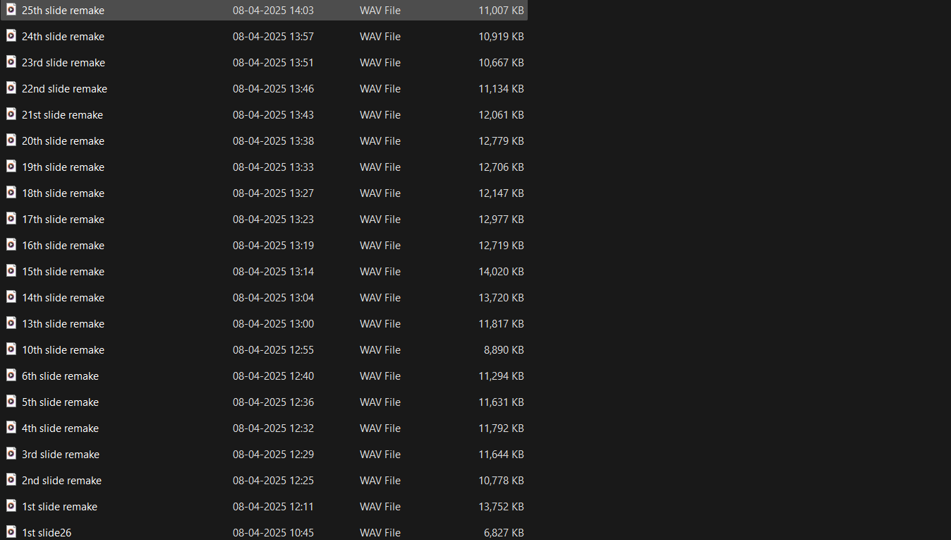
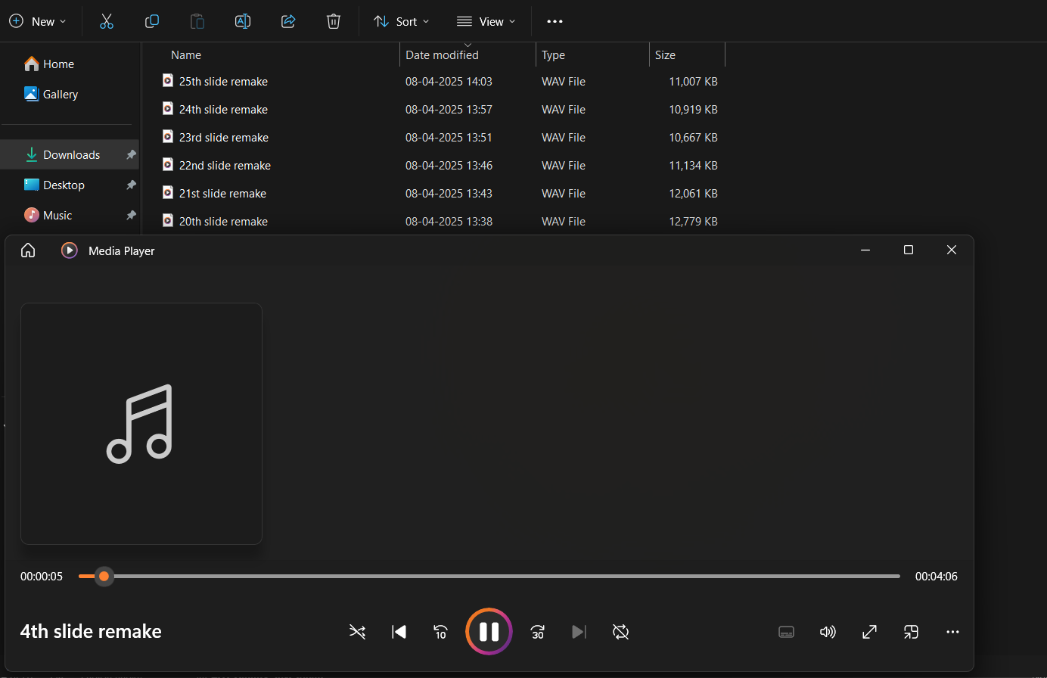
Content Moderation

Slide 25
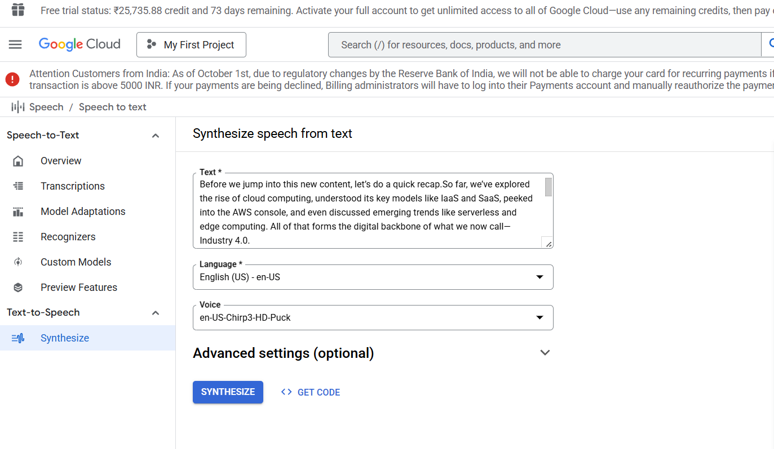
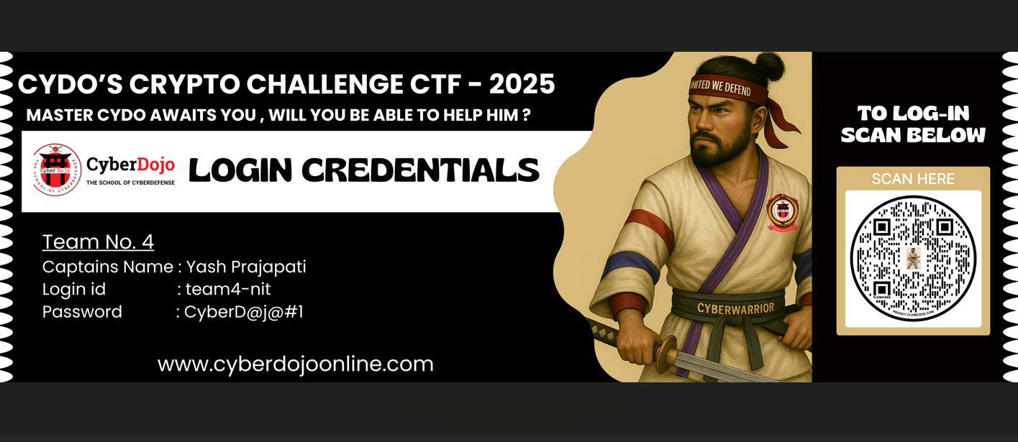
Content Moderation

Slide 26
CISCO Packet Tracer
Cisco Packet Tracer is a powerful network simulation tool developed by Cisco for learning, designing, and testing network configurations in a virtual environment. It allows users to create complex network topologies using routers, switches, PCs, servers, and IoT devices, making it an essential tool for students and professionals preparing for Cisco certifications like CCNA and CCNP. With its user-friendly interface and support for both CLI and graphical configuration, Packet Tracer provides a hands-on experience in networking concepts such as routing, switching, VLANs, and network security. Additionally, it enables multiuser collaboration and supports programming languages like Python and JavaScript for automation. As a free tool provided through Cisco Networking Academy, it serves as an excellent platform for practicing and enhancing networking skills before working on real-world networks.

Slide 27
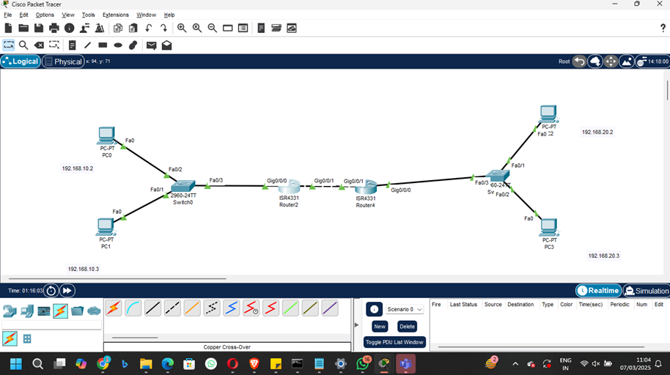
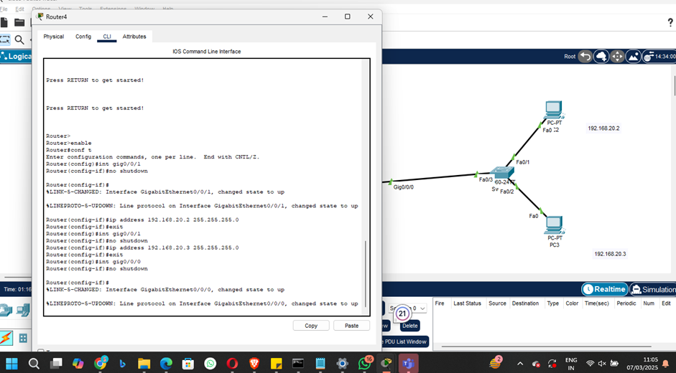
CISCO Packet Tracer

Slide 28
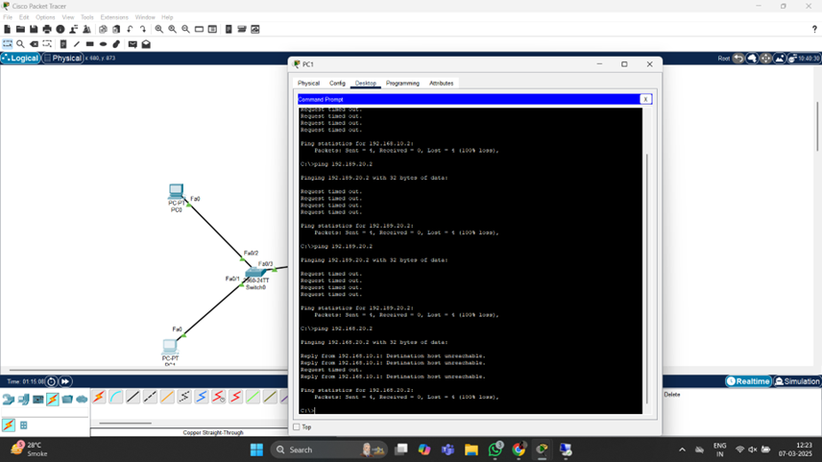
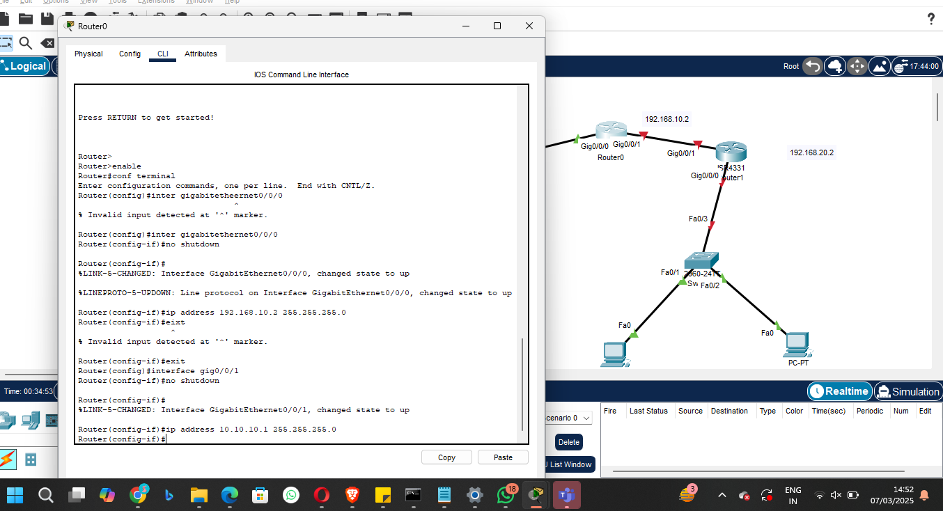
CISCO Packet Tracer

Slide 29
Lab Instances/Firewall configuration
"I'm currently involved in setting up and managing lab instances for hands-on cybersecurity training as part of my work in the ed-tech domain. This includes deploying and configuring virtual machines, establishing secure network environments, and implementing robust firewall configurations to regulate network traffic and protect lab resources from unauthorized access. I work extensively on defining and refining firewall rules, managing access control lists, and simulating real-world cyber threats to provide learners with a realistic, immersive experience. My responsibilities also include troubleshooting connectivity issues, ensuring system hardening, and maintaining the overall integrity and functionality of the lab infrastructure. Through this work, I've developed a strong foundation in networking concepts, system administration, and cybersecurity best practices, while also contributing to the design of practical learning modules aligned with industry standards."

Slide 30
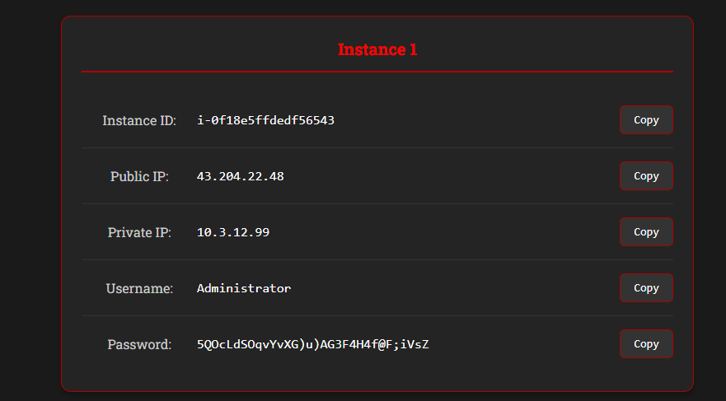
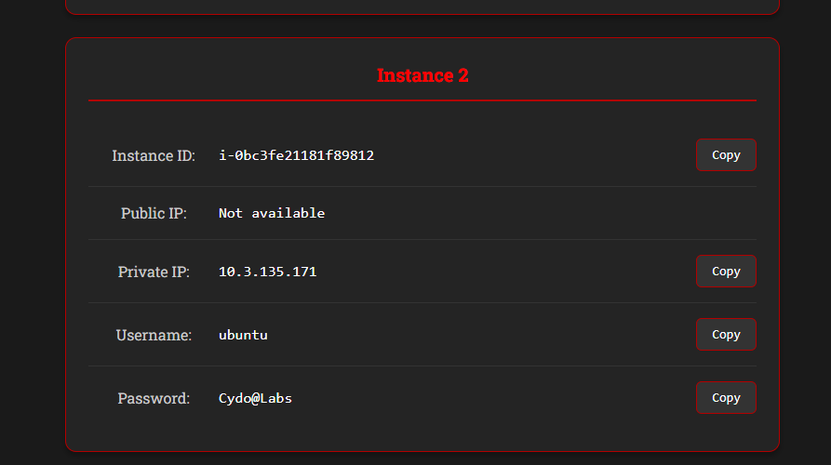
Lab Instances/Firewall configuration

Slide 31
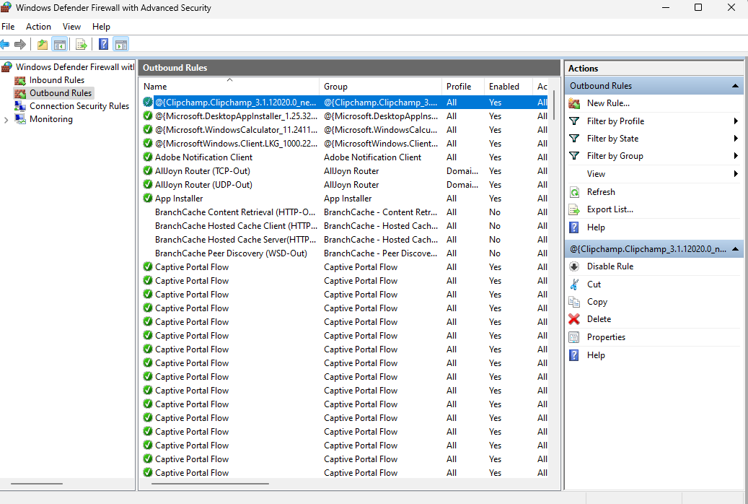
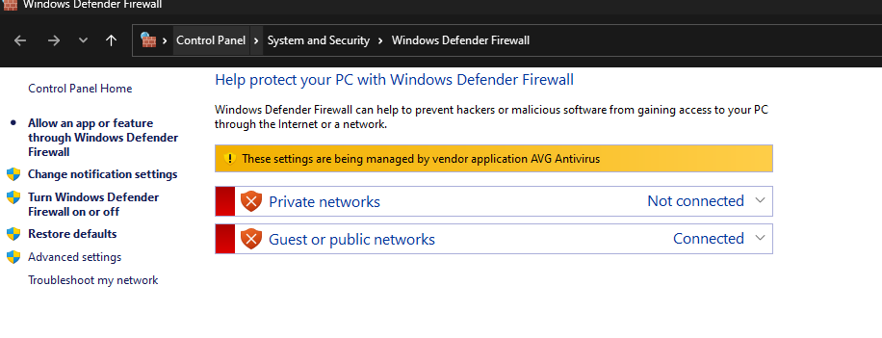
Lab Instances/Firewall configuration

Slide 32
Kali Linux
Kali Linux is a powerful, Debian-based Linux distribution designed for cybersecurity professionals, ethical hackers, and penetration testers. Developed by Offensive Security, it comes pre-installed with a vast collection of security tools for penetration testing, digital forensics, reverse engineering, and network analysis. Kali Linux supports a wide range of hardware platforms and architectures, making it versatile for different environments, including desktops, virtual machines, and embedded systems. With features like customizable installations, a rolling release model, and extensive community support, Kali Linux is a preferred choice for security experts. Its tools, such as Metasploit, Nmap, Wireshark, and Aircrack-ng, make it an essential operating system for ethical hacking and cybersecurity research.

Slide 33
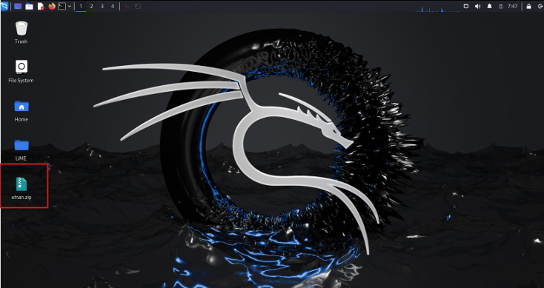
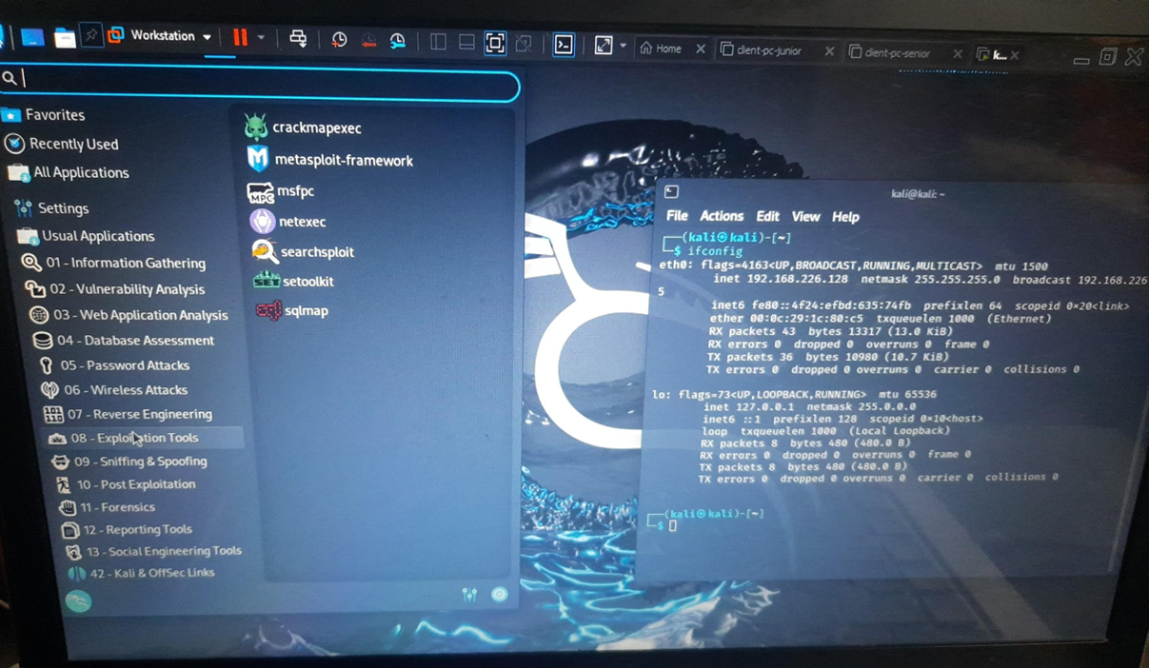
Kali Linux

Slide 34
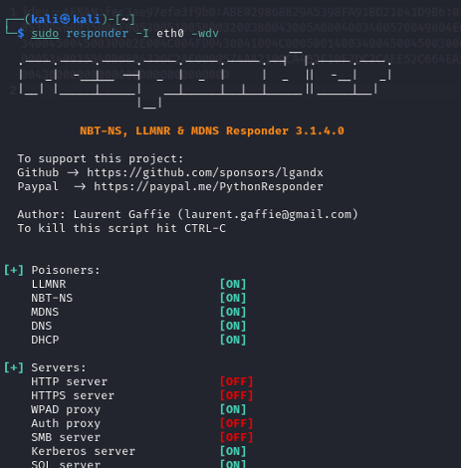
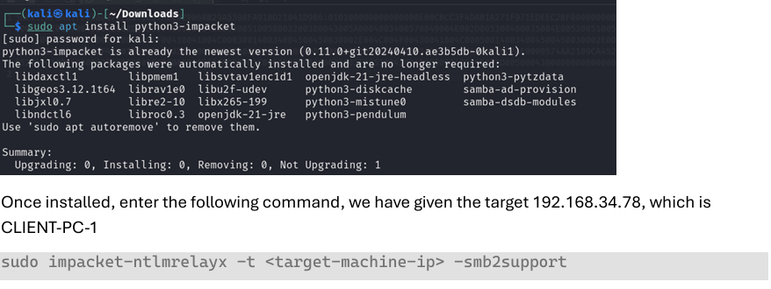
Kali Linux

Slide 35

Internship completion certificate

Slide 36
Sustainable development goals
The most relevant Sustainable Development Goals (SDGs) it maps to are:
SDG 4: Quality Education
Your development of a cybersecurity awareness training course and guidebooks directly supports inclusive and equitable quality education by improving digital literacy and security awareness among employees.
User training modules, simulated phishing tests, and continuous learning features contribute to lifelong learning opportunities.

Slide 37
Sustainable development goals
SDG 9: Industry, Innovation, and Infrastructure
You built a cybersecurity solution integrated into project management systems, which aligns with fostering innovation and building resilient infrastructure.
Your implementation of automation, real-time threat detection, and secure communication systems reflects innovation in industry practices.

Slide 38
Sustainable development goals
SDG 8: Decent Work and Economic Growth
By enhancing organizational security and efficiency, your project supports productive employment and fosters a secure work environment.
The project management and event planning skills you applied contribute to enhancing workplace productivity and planning.

Slide 39
Sustainable development goals
SDG 16: Peace, Justice, and Strong Institutions
Your cybersecurity solution promotes data integrity, privacy, and protection against cybercrime, contributing to stronger institutions and secure digital environments.
The focus on user responsibility and awareness reinforces institutional resilience against internal and external digital threats.

Slide 40

Sustainable development goals

Slide 41
Internship Road Map
Note: Write in the below table what u will be achieving in each review
Review 0
brief
Review 1
brief
Review 2
Brief understanding of
Test case
Scenarios
Review 3
understanding of
organization
understanding of
Assigned work
Brief
Explanation
Of
All assigned work and tools used

Slide 42
Github Link
https://github.com/HarshAbhinavA

Slide 43
Q&A

Slide 44
Thank you !!

